Slide 1
Algorithm Analysis
Notes:
So far, you have acquired proficiency in programming. This course will start the process of your transformation from a programmer to a computer scientist. One of the important tasks of a computer scientist is to make efficient use of computational resources. This course will teach you about different ways of organizing the data to facilitate such efficient use, and will also discuss efficient techniques to perform some fundamental operations in computer science. We will teach you to use the techniques discussed in this course to solve commonly encountered computer science problems efficiently. We will also teach you to analyze the efficiency, and prove the correctness, of your program in a mathematically rigorous manner. Material you learn is critical to your becoming a good software developer later.

Slide 2
What to Analyze
Running time, space, etc.
  Depends on the input
  Depends on the input size
    Parameterize in input size
  Want the upper bound
    Guarantee to the user

Slide 3
Kind of Analysis
Worst case (usually)
  T(n) = maximum time on any input of size n
Average case (sometimes)
  T(n) = expected time over all inputs of size n
Best case (bogus)

Slide 4
What is the worst case running time?
Depends on the computer used
  Relative speed (on same machine)
  Absolute speed (on diff machine)
Huge Idea: Asymptotic Analysis
  Ignore machine dependent constants
  Look at the growth of the running time, T(n) as n → ∞

Slide 5
Asymptotic Analysis
Compares growth of two functions
Independent of constant multipliers and lower-order effects
Metrics
  “Big O” Notation O()
  “Big Omega” Notation Ω()
  “Big Theta” Notation Θ()
Notes:
Computational Complexity
Computational complexity provides a language for comparing the growth of functions that are defined on (all but finitely many) non-negative integers and which have non-negative real number values. The important class of examples that we will use are functions whose values are run time or run space of an algorithm, and whose input is a number representing the size of the data set on which the algorithm operates.
Complexity of a function is dependent only on its eventual behavior, that is, complexity is independent of any finite number of initial values. The practical effect of this is to ignore initialization phases of algorithms.
Complexity of a function is independent of any constant multiplier. The practical effect of this is to ignore differences in such things as processor speed when comparing performance of two algorithms.
The properties just stated come directly from the definition of computational complexity. A more subtle property, deducible from the definition, is that complexity is independent of so-called "lower order" effects. We will not attempt to make this last statement precise, but we will give some examples to illustrate the concept.
The key measures of computational complexity are known as "Big O" notation, "Big Omega" notation, and "Big Theta" notation. You should be somewhat familiar with at least some of these. The definitions appear in the next slide.

Slide 6
Pseudocode
Example: find max element of an array
High-level description of an algorithm
More structured than English prose
Less detailed than a program
Preferred notation for describing algorithms
Hides program design issues
Algorithm arrayMax(A, n)
Input array A of n integers
Output maximum element of A
currentMax ← A[0]
for i ← 1 to n − 1 do
if A[i] > currentMax then
currentMax ← A[i]
return currentMax

Slide 7
Pseudocode Details
Control flow
  if … then … [else …]
  while … do …
  repeat … until …
  for … do …
  Indentation replaces braces
Method declaration
  Algorithm method (arg [, arg…])
  Input …
  Output …
Method call
  var.method (arg [, arg…])
Return value
  return expression
Expressions
  Assignment
  (like = in C++)
  Equality testing
  (like == in C++)
  n² Superscripts and other mathematical formatting allowed

Slide 8
Big “O” Notation
f(n) =O(g(n))
  If and only if
    there exist two constants c > 0 and n₀ > 0,
    such that f(n) ≤ cg(n) for all n ≥ n₀
  iff ∃ c, n₀ > 0 s.t. ∀ n ≥ n₀ : 0 ≤ f(n) ≤ cg(n)
cg(n)
f(n)
f(n) is eventually
upper-
bounded by g(n)
n₀
Notes:
Asymptotic Relations and Notation
The Big O class of a function f consists of all functions that are "asymptotically bounded above by f". The official definition from [Cormen] follows:
g(n) is in O(f(n)) if and only if there exist positive constants c and n₀ such that 0 <= g(n) <= cf(n) for all n >= n₀
Notice that f(n) is in O(f(n)), as are 100f(n) and 100 + f(n). Notice also that the condition defining O(f(n)) is an upper bound condition. Big Omega is defined using the corresponding lower bound condition:
g(n) is in Ω(f(n)) if and only if there exist positive constants c and n₀ such that 0 <= cf(n) <= g(n) for all n >= n₀
and Big Theta is defined using both at once:
g(n) is in Θ(f(n)) if and only if there exist positive constants c₁, c₂, and n₀ such that 0 <= c₁f(n) <= g(n) <= c₂f(n) for all n >= n₀

Slide 9
Example:
Inventory
  10,000 ms to read inventory from disk
  10 ms to process each transaction
  The running time to process n transactions,
  T(n) = 10,000 + 10 n = O(n)

Slide 10
Big “Omega” Notation
f(n) = Ω(g(n))
  iff ∃ c, n₀ > 0 s.t. ∀ n ≥ n0 , 0 ≤ cg(n) ≤ f(n)
f(n)
cg(n)
f(n) is eventually
lower-bounded by g(n)
n₀

Slide 11
Big “Theta” Notation
f(n) = Θ(g(n))
  iff ∃ c₁, c₂, n₀ > 0 s.t. 0 ≤ c₁g(n) ≤ f(n) ≤ c₂g(n), ∀ n >= n₀
c₂g(n)
f(n)
f(n) has the
same long-term
rate of
growth as g(n)
c₁g(n)
n₀

Slide 12
Examples
3n² + 17
Ω(1), Ω(n), Ω(n²) ➔ lower bounds
O(n²), O(n³), ... ➔ upper bounds
Θ(n²) ➔ exact bound

Slide 13
Little “o” Notation – a weaker upper bound
T(n) = ο(f(n)) if T(n) = O(f(n)) but T(n) ≠ Θ(f(n))
Example:
  f(n) = n + 1
  o(n² ), o(n³ ), o(2^{n})

Slide 14
Mathematical Definition of Asymptotic
Limit _{n→∞} f(n)/g(n) = L
L = 0 ➔ f(n) = o(g(n))
L = c ≠ 0, ➔ f(n) = Θ(g(n))
L = ∞ ➔ g(n) = o(f(n))
The limit oscillates: there is no relation

Slide 15
Analogous to Real Numbers
f(n) = O(g(n)) (a ≤ b)
f(n) = Ω(g(n)) (a ≥ b)
f(n) = Θ(g(n)) (a = b)
…The above analogy is not quite accurate, but its convenient to think of function complexity in these terms
Caveat: The “hidden constants” in the Big-notations can have real practical implications.

Slide 16
Arithmetic Properties
Additive Property
  If e(n) = O(g(n)) and f(n) = O(h(n))
  Then e(n) + f(n) = O(g(n) + h(n))
  = max (O(g(n)) , O(h(n)))
Multiplicative Property
  If e(n) = O(g(n)) and f(n) = O(h(n))
  Then e(n)•f(n) = O(g(n) • h(n))

Slide 17
Typical Growth Rates
Function Name
f(x) = c, c ∈ R | Constant
log(N) | Logarithmic
log²(N) | Log-squared
N | Linear
N log(N)
N² | Quadratic
N³ | Cubic
2^{N} | Exponential

Slide 18
Some Rules of Thumb
If f(n) is a polynomial of degree k
  Then f(n) = Θ(N^{k})
log^{k}N = O(N), for any k
  Logarithms grow very slowly compared to even linear growth

Slide 19
Big Oh Examples
f(n) | = O( ) | Comments
3n+2 | O(n)
3n+3
100n +6
10n²+4n+2
1000n² +100n- 6
6*2^{n}+n²
2033
3n+2 ≤ 4n for n>=2
O(n)
3n+3 ≤ 6n for n>0
O(n)
100n+6 ≤ 106n for n>0
O( n² )
10n² +4n +2 ≤ 16n² for n>0
O( n²)
1000n² +100n-6 ≤ 1100n² for n>0
O( 2^{n})
6*2^{n}+n² ≤ 7*2^{n} for n>0
O(1)
2033 <2034 for all n

Slide 20
Maximum Subsequence Problem
Given a sequence of integers A₁, A₂, …, A_{N}
  Find the maximum subsequence (A_{i} + A_{i+1} + … + A_{k}),
  where 1 ≤ i ≤ N
  For input -2, 11, -4, 13, -5, -2, the answer is 20 (A₂-A₄)
  Many algorithms of different complexity can be found
Algorithm time
Input Size | 1 O(N³) | 2 O(N²) | 3 O(N*logN) | 4 O(N)
N=10 | 0.000009 | 0.000004 | 0.000006 | 0.000003
N=100 | 0.002580 | 0.000109 | 0.000045 | 0.000006
N=1,000 | 2.281013 | 0.010203 | 0.000485 | 0.000031
N=10,000 | N.A. | 1.2329 | 0.005712 | 0.000317
N=100,000 | N.A. | 135 | 0.064618 | 0.003206

Slide 21
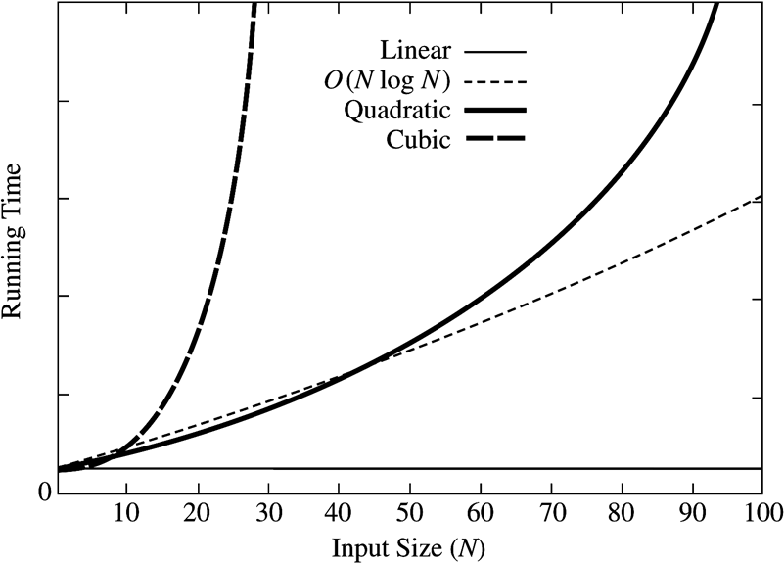
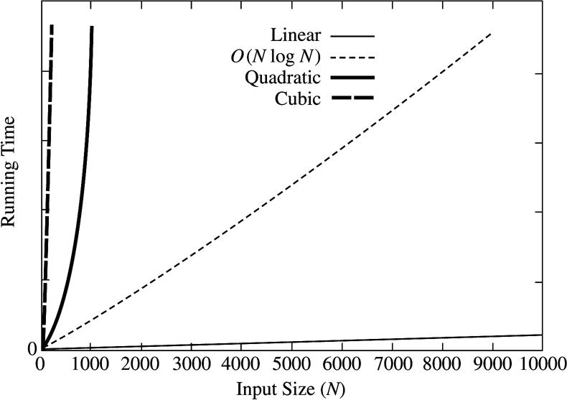
Maximum Subsequence Problem :
How Complexity affects running times

Slide 22
Exercise
f(N) = N logN and g(N) = N ^{1.5}
  Which one grows faster??
Note that g(N) = N ^{1.5} = N•N ^{0.5}
  Hence, between f(N) and g(N), we only need to compare growth rate of log(N) and N ^{0.5}
  Equivalently, we can compare growth rate of log²N with N
  Now, we can refer to the previously state result to figure out whether f(N) or g(N) grows faster!

Slide 23
Put the following in order of growth rate
n, n^{1/2} , n^{1.5} , n² , n (lg n), n(lg (lg(n)), nlg² (n),
n lg n² , 2/n , 2^{n} , 2^{n/2} , 37, n² (lg(n)), n³
Slowest
2/n | 37 | n^{1/2} | n | nlg(lg(n)) | n lg(n)
n lg(n²) | nlg²(n) | n^{1.5} | n² | n² (lg(n)) | n³
2^{n/2} | 2^{n}
 |  |  |  |  | Fastest

Slide 24
Complexity Analysis
Estimate n = size of input
Isolate each atomic activities to be counted
Find f(n) = the number of atomic activities done by an input size of n
Complexity of an algorithm =
complexity of f(n)
Notes:
Algorithm Complexity
To apply the notation and theory of computational complexity to algorithms is a four step process. First discover a measure of size of input to the algorithm. Second, decide on a notion of atomic computational activity that captures the work of the algorithm. Third, find the function f(n) = the number of atomic computations performed on input of size n. Finally, the complexity of the algorithm is the complexity of f(n). We illustrate this process in several examples as we conclude this chapter, as well as in various places throughout the remainder of the course.

Slide 25

Computing Prefix Averages
The i-th prefix average of an array X is average of the first (i + 1) elements of X:
A[i] = (X[0] + X[1] + … + X[i])/(i+1)
Computing the array A of prefix averages of another array X has applications to financial analysis

Slide 26
Prefix Averages (Quadratic)
The following algorithm computes prefix averages in quadratic time by applying the definition
Algorithm prefixAverages1(X, n)
Input array X of n integers
Output array A of prefix averages of X #operations
A ← new array of n integers n
for i ← 0 to n − 1 do n
s ← X[0] n
for j ← 1 to i do 1 + 2 + …+ (n − 1)
s ← s + X[j] 1 + 2 + …+ (n − 1)
A[i] ← s / (i + 1) n
return A 1

Slide 27
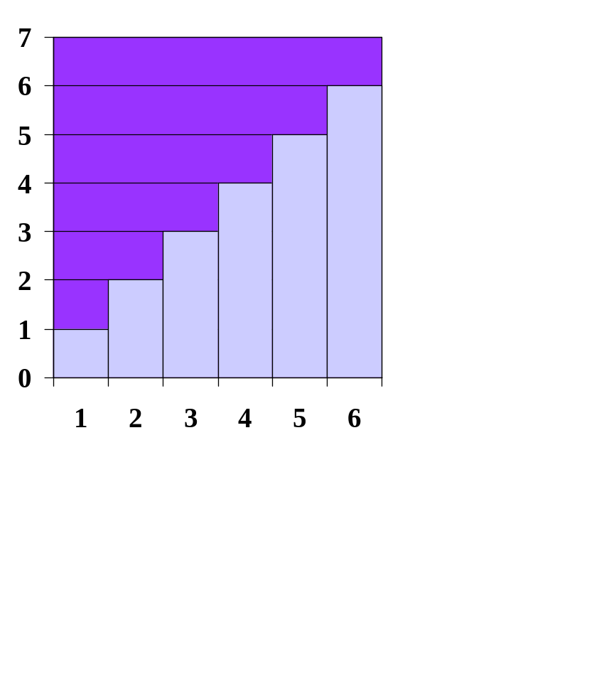
Arithmetic Progression
The running time of prefixAverages1 is
O(1 + 2 + …+ n)
The sum of the first n integers is n(n + 1) / 2
  There is a simple visual proof of this fact
Thus, algorithm prefixAverages1 runs in O(n²) time

Slide 28
Prefix Averages (Linear)
The following algorithm computes prefix averages in linear time by keeping a running sum
Algorithm prefixAverages2(X, n)
Input array X of n integers
Output array A of prefix averages of X #operations
A ← new array of n integers n
s ← 0 1
for i ← 0 to n − 1 do n
s ← s + X[i] n
A[i] ← s / (i + 1) n
return A 1
Algorithm prefixAverages2 runs in O(n) time

Slide 29
Running Time Calculations -
Loops
for (j = 0; j < n; ++j) {
// 3 atomics
}
Complexity = Θ(3n) = Θ(n)
Notes:
Algorithm Complexity - Loops
Despite the facetious remarks we made earlier about how "obvious" it is that a simple fixed-bound loop terminates, it actually is true that simple loops are straightforward to analyze. Usually it is clear when and why they terminate and what computational work is accomplished in each iteration of the loop body. If, for example we define an atomic computation as a call to a comparison operator, there might be three such calls in the loop body. That situation is depicted in the slide. The complexity of the loop is defined to be the complexity of the function
f(n)
= (no. of atomics in loop body) x (no. of iterations of loop)
= (3) x (n)
= 3n
Thus, the complexity of this loop is equal to
Θ(f(n))
= Θ(3n)
= Θ(n)
The situation is often not quite this simple, however.

Slide 30
Loops with Break
for (j = 0; j < n; ++j) {
// 3 atomics
if (condition) break;
}
Worst case time = O(4n) = O(n)
Best case time = O(1)
Notes:
Algorithm Complexity - Loops with Break
The case of a loop with a conditional breakout is shown in this slide. In the cases where the loop runs to normal termination, the run time of the loop is correctly modelled by the same function as for the simple loop above. But in other cases, the loop may terminate sooner. These cases are data dependent; that is, the runtime of the loop varies from an upper bound of 3n = O(n) to a lower bound of 3 = Ω(1), depending on the specific input to the loop. We cannot conclude that the algorithm has complexity Θ(n) because the lower bound condition >= Ω(n) does not hold. Therefore, the best we can conclude is that the loop has complexity <= O(n).

Slide 31
Loops in Sequence
for (j = 0; j < n; ++j) {
// 3 atomics
}
for (j = 0; j < n; ++j) {
// 5 atomics
}
Complexity = Θ(3n + 5n) = Θ(n)
Notes:
Algorithm Complexity - Loops in Sequence
This slide shows two loops one following the other in the source code. These are sometimes referred to as concatenated loops. Concatenated program blocks execute in sequence, one after another. Therefore the runtime of two concatenated blocks is the sum of the runtimes of the individual blocks. For the situation depicted on the slide, the runtime is bounded above by O(3n + 5n) <= O(n).

Slide 32
Nested Loops
for (j = 0; j < n; ++j) {
// 2 atomics
for (k = 0; k < n; ++k) {
// 3 atomics
}
}
Complexity = Θ((2 + 3n)n) = Θ(n²)
Notes:
Algorithm Complexity - Loops Nested
This slide shows two loops one inside the other in the source code. These are sometimes referred to as composed loops. The runtime of two composed blocks is the product of the runtimes of the individual blocks. Thus, the runtime of the composed loops depicted in the slide is bounded above by O((2 + 3n)n) <= O(2n + 3n²)) <= O(n²).

Slide 33
Consecutive Statements
Complexity =
O(2n) + O((2+3n)n)
= O(n) + O(n²) = ??
= O(n²)
for (i = 0; i < n; ++i) {
// 1 atomic
if(condition) break;
}
for (j = 0; j < n; ++j) {
// 1 atomic
if(condition) break;
for (k = 0; k < n; ++k) {
// 3 atomics
}
if(condition) break;
}

Slide 34
If-then-else
if(condition)
i = 0;
else
for ( j = 0; j < n; j++)
a[j] = j;
Complexity = ??
= O(1) + max ( O(1), O(N))
= O(1) + O(N)
= O(N)

Slide 35
Sequential Search
Given an unsorted vector a[], find if the element X occurs in a[]
for (i = 0; i < n; i++) {
if (a[i] == X) return true;
}
return false;
Input size: n = a.size()
Complexity = O(n)
Notes:
Algorithm Complexity - Sequential Search
This slide shows the usual (more efficient) version of sequential search in which there is early breakout of the loop immediately upon successful search. This is modelled by the simple loop with break, and hence has complexity <= O(n).

Slide 36
Binary Search
Given a sorted vector a[], find the location of element X
unsigned int binary_search(vector<int> a, int X)
{
unsigned int low = 0, high = a.size()-1;
while (low <= high) {
int mid = (low + high) / 2;
if (a[mid] < X)
low = mid + 1;
else if( a[mid] > X )
high = mid - 1;
else
return mid;
}
return NOT_FOUND;
}
Input size: n = a.size()
Complexity: O( k iterations x (1 comparison + 1 assignment) per loop)
  = O(log(n))
Notes:
Algorithm Complexity - Binary Search
This algorithm consists of a single loop that does not have any abnormal breakout termination, so the complexity of the loop is essentially the number of loop iterations as a function of n = size of input. Some helpful observations (derived from our previous analysis of correctness) follow.
Observation 1. The loop terminates after the search range is reduced to size <= 1.
Observation 2. The search range is n = size for the first iteration of the loop.
Observation 3. The search range is reduced by 1/2 at each iteration.
Thus, the loop runs for as many times as we can divide n by 2 before reaching the value 1. The first k sizes in these iterations are n, n/2, n/4, n/8, ..., n/2^{k-1}, and the loop termination condition is
n/2^{k-1} == 1 equivalent to n == 2^{k-1} equivalent to log₂n == k-1.
The last inequality shows that the loop terminates in log₂n iterations (give or take one). The complexity of binary search is therefore Θ(log₂n). An exercise for this chapter is to verify the three observations.

Slide 37
Recursion
long factorial( int n )
{
if( n <= 1 )
return 1;
else
return n * factorial( n - 1 );
}
long fib( int n )
{
if ( n == 0)
return 0;
else if ( n == 1)
return 1;
else
return fib( n – 1 ) + fib( n – 2 );
}
This is really a
simple loop
disguised as recursion
Complexity = O(n)
Fibonacci Series:
Terrible way to
Implement recursion
Complexity = Ω( (3/2)^{N} )
That’s Exponential !!

Slide 38
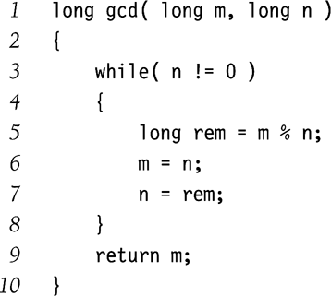
Euclid’s Algorithm
Find the greatest common divisor (gcd) between m and n
  Given that m ≥ n
Complexity = O(log(N))

Slide 39
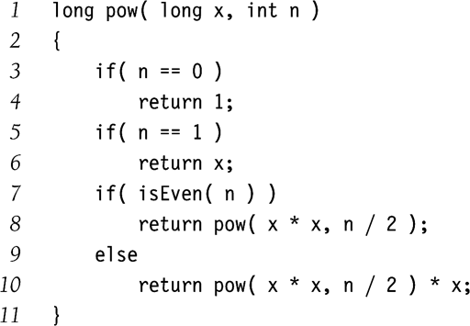
Exponentiation
Calculate x^{n}
Example:
  x¹¹ = x⁵ * x⁵ * x
  x⁵ = x² * x² * x
  x² = x * x
Complexity = O( logN )
Why didn’t we implement the recursion as follows?
  pow(x,n/2)*pow(x,n/2)*x

Slide 40
Space Complexity
Every programs space can be divided into 2 parts
  A fixed size for constants and instructions
  A part that varies according to the instance.
Hence the space required by the program P running on a instance I is given by : S(P) = c+ S_{P}(I)

Slide 41
Computing S_{P}(I)
Function calls need to allocate space for local variables.
In recursion the S_{p}(I) is the number of recursive calls.
If the function allocates memory using “new” then it also uses space.
Subtly the function allocates space when it uses vectors.

Slide 42
Space Example
int foo(int n)
{
for (int i = 0; i< n*n; i++)
for (int j = 0; j< i; j++)
x++;
return x;
}// Sp(I) = Θ(1)
int foo(int A[], int n)
{
for (int j = 0; j< n; j++)
A[x]++;
return x;
}// Sp(I) = Θ(1)

Slide 43
Space Example2
int foo( int n)
{
int *A;
A = new int[n];
// stuff
return A[3];
}// Sp(I) = Θ( n )

Slide 44
Space Example 3
int foo(int A[], int begin, int end, int n, int target)
{
if (begin <= end) {
int mid =(begin+ end)/2;
if (target == A [ mid])
return mid;
else if (target < A[mid])
return (foo(A, begin, mid-1, n/2-1,target));
else
return (foo(A, mid+1, end, n/2 -1, target));
}
Return NOT_FOUND;
}// Sp(I) = Ο( log(n) )

Slide 45
Space Example 4
int foo(int A[], int n, int target)
{
if (n >0) {
if (target == A [n-1])
return n-1;
else
return (foo(A, n-1, target));
}
return NOT_FOUND
}// Sp(I) = Θ( n )

